Slide 1
Class D – Can We Achieve It?
A look at the Challenges of a T-BC
David Spencer – ITSF 2020

Slide 2
Network and Equipment Limits
Operators care about the end-to-end performance
Network Limit
A Telecom Boundary Clock (T-BC) vendor only controls their portion
Equipment Limit
Standards are crafted so that building a defined network with devices that meet the equipment limit will ensure the network limit is met

Slide 3

T-BC Classes
Not all networks are the same
Different size
Different application
To provide flexibility ITU-T G.8273.2 defines four classes of T-BC
Different performance for different networks and applications
Differences relate to performance only
T-BC Class | Intended Application | Network Size | End-to-end Performance
A | Backhaul | Short (10 hops) | 1.5 µs
B | Backhaul | Long (20 hops) | 1.5 µs
C | Fronthaul | Very short (5 hops) | 130 ns
D | Flexible | Very long | Application Specific

Slide 4
T-BC Performance Limits
Parameter | Measurement | Class A | Class B | Class C | Class D
Max |TE| | Unfiltered | 100 ns | 70 ns | 30 ns | -
Max |TE_{L}| | Low pass | - | - | - | 5 ns
cTE | Averaged | 50 ns | 20 ns | 10 ns | -
dTE_{L} (MTIE) | Low pass | 40 ns | 40 ns | 10 ns | -
dTE_{L} (TDEV) | Low pass | 4 ns | 4 ns | 2 ns | -
dTE_{H} | High pass | 70 ns | 70 ns | - | -
→ Class B is Class A with tighter cTE requirement
→ Class C tightens both cTE and dTE over Class B
→ Class D limits are so small that only a single overall number is specified (currently)

Slide 5

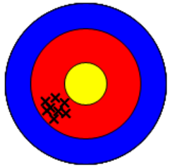
Distinguishing cTE vs dTE
dTE:
Averages to zero over a long enough period
Can therefore be filtered (in theory)
Typically uncorrelated between nodes so doesn’t accumulate
Relates to precision: Time stamping resolution and local clock stability
cTE:
Doesn’t change over meaningful time period
So cannot be filtered
Accumulates node to node
Relates to accuracy: Time stamping static error (PHY & clock distribution errors)
cTE is our enemy – accumulates across nodes and cannot be filtered

Slide 6
cTE: The challenge
To reduce cTE, timestamping must be accurate
Capture exact time that frame comes off the wire
But a real system has inaccuracies
Delay in PHY between frame arriving and timestamp trigger
Distribution delay from local clock to timestamper
PHY delay is a function of PHY design
Select a part with small delay variation
Distribution delay is a bigger problem …
… and what we’ll look at here

Slide 7
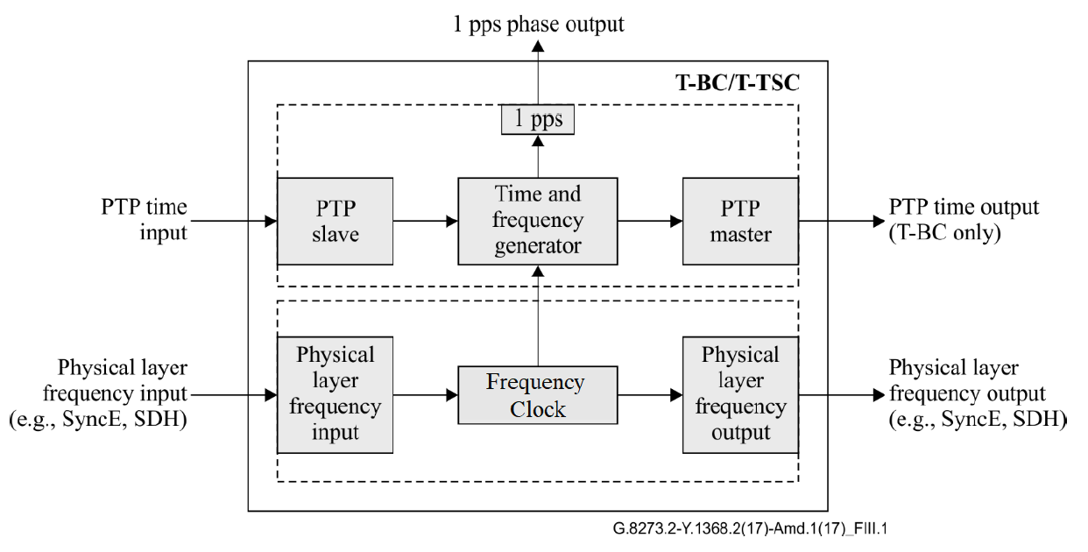
Hypothetical Model vs. Reality
How ITU-T sees a T-BC
What a typical T-BC looks like
Disconnect between model and reality
Implementation has to deal with architecture distributed across multiple cards in a chassis

Slide 8
1PPS Distribution: Time Alignment and Delay Handling
CONFIDENTIAL SILICON LABS
ΔT delays are adjusted to achieve → (ΔTs + δS) = (ΔTm1 + δ1) = (ΔTm2 + δ2) = ΔTt
Servo adjusts Ttc to achieve → Tlcs (local time) = Tm (master’s time)
Ttc == Tm + (ΔTs + δS)
ie Timing card ToD will lead actual time by 1PPS backplane delay to the slave line card + the configured 1PPS input delay on the slave line card
Since ΔTt = (ΔTm1 + δ1) = (ΔTm2 + δ2) = (ΔTs + δS) therefore Tt, Tlcm1 and Tlcm3 will all be aligned with Tm

Slide 9
Solution 1: Manual Calibration of 1PPS Distribution Path
Backplane Trace Delays
1PPS backplane trace delays are manually measured
Variance in PCB trace length during manufacturing causes delay uncertainty
Backplane Driver/Receiver Delays
Driver + Receiver delay
Line Card PLL
Keep I-O delay as low as possible with zero-delay mode
All deterministic delays can be compensated for using adjustable delay at Line Card PLL.
Challenges:
Delay uncertainty from PCB traces, drivers/receivers, and Line Card PLL adds to the time error budget
Drivers/receiver delay uncertainty is the main contributor

Slide 10
Solution 2: On-chip 1PPS Delay Measurement & Adjust
Measuring 1PPS path delays
1PPS path delays are measured for each card at start-up
Delay measurement performed at central point in the system. In this case at the Timing Card.
Could use existing SyncE backplane traces to provide return path
Measured trace delay differences are adjusted at line cards
1PPS delay = Round Trip Delay minus Return Path delay
Advantage:
Compensates for both backplane trace delay and driver/receiver delay uncertainty
Challenges:
Assumption that forward and return paths are symmetrical
Return path must also be measured (using TxSyncE/RxSyncE pair?)

Slide 11

Conclusion
Class D is tough
5 ns total time error to cover:
PHY delay variability in slave port
Alignment of slave port timestamper to local clock
Alignment of each master port timestamper to local clock
PHY delay variability in each master port
… and any low frequency dynamic errors
But we can do it if we have:
PHYs with very well controlled internal delays
Carefully designed clock distribution networks supported by timing ICs that feature
Programmable per-input delays
Internal delay measurement and compensation
Two-way (feedback) delay measurement
Multiple outputs to eliminate external fanout buffers

